Slide 1
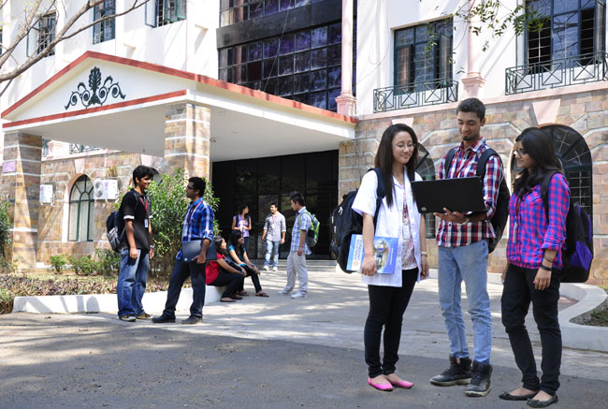

B.Tech Computer Science and Engineering – Vth Semester
Introduction to Context Free Languages
Department of Computer Science and Engineering

Slide 2
Limitation of Regular Languages
Regular Languages have limited expressive capabilities.
For example the following language cannot be expressed using regular Languages.
Represents language with equal number of a’s followed by equal number of b’s.
In fact regular languages cannot represent any language which has regular repetitions.
For example all expressions with balanced open and closed parenthesis and string of palindromes.

Slide 3
Context Free Grammar - CFG
A technique used to express a special set of languages which are called as Context Free Languages.
Context Free Languages are more sophisticated and can represent wider set of languages.
Language | Expressed Using | Recognizing Machines | Used for
Regular Languages | Regular Expressions | DFA, NFA and Epsilon NFA | Expressing individual words in a language
Context Free Languages | Context Free Grammars | Push Down Automata(PDA) and Turing Machines | Used for expressing sentences in a language.

Slide 4
Definition of Context Free Grammars CFGs
There are 4 components in a CFG G=(V,T,P,S)
Definite Set of symbols that forms the strings of the language, we call this alphabet as TERMINALS or TERMINALS SYMBOLS represented using T.
A finite set of variables that are called as NON TERMINALS or syntactic categories represented using V.
One of the variables is termed as START SYMBOL represented using S.
There are finite set of PRODUCTIONS or RULES that represents the recursive definition of language represented using P.

Slide 5
The Productions Rules
Each production rules consists of
A variable that is being defined by the production. This variable sometimes called as head of the production.
The production symbol “->”.
A string of zero or more terminals or variables or both usually called as the body of the production.
The production A->aB means
If you see ‘A’ any where you can replace or expand that with “aB”.

Slide 6
A sample CFG which represents a palindrome
P->ε
P->0
P->1
P->0P0
P->1P1
Then the quadruples of the language can be represented as
G={{P},{0,1},A,P}
Here ‘A’ is just used for representational purpose which represents the set of productions.

Slide 7
Let us consider an trivial example
S->A
A->a
Find out the string produced by this CFG
How do I do that??
S->A the LHS can be replaced with RHS.
Replace S with A
A is again a variable ..so search for any matching definition of A
A->a which means ‘A’ can be replaced with ‘a’
as there is no possibility for further replacement.
The string represented by the above CFG is ‘a’

Slide 8
How to Identify Non Terminals or Variables, terminals and starting symbol???
S->AB
A->a
B->b
Non Terminals or Variables – ALL capital letter symbols ex A, B,…
Terminals – {a,b} – Small letters, operators, digits,paranthesis, etc…(same as regular languages)
Starting Symbol is a Variable – if not specified either LHS of top most production or LHS of bottom most production.

Slide 9
Identify the V T and S
The CFG G is
S->0S1
S->01
---------------- the answer is --------------
V={S}
T={0,1}
S={S}

Slide 10
Identify the V T and S
A->a 1.S->AB
B->b 2.A->Aa
A->Aa 3.A->a
B->Bb 4.B->Bb
S->AB 5.B->b
V={S,A,B}
T={a,b}
S={S}
The two representations of the CFG represents the same Language.
Identify the V T and S

Slide 11
A sample Derivation
Find the string(s) represented by the above CFG.
S->AB
A->a
B->b
-----------------------
S->AB (1)
->aB (2)
->ab (3)
The string derived from the CFG is “ab”
The process of deducing strings of terminals from the starting symbol by recursively replacing non terminals is called as derivation.

Slide 12
Thank You

